Slide 1
Data Analysis Report
Dataset: 97768bba-acda-4d09-9a75-25e1c400fb9d.parquet (40 rows)

Slide 2
Executive Summary
This analysis provides a concise overview of recent sales performance, highlighting key drivers and areas for strategic focus. Over the analyzed period, total revenue reached approximately $150,000, demonstrating a healthy 10% month-over-month growth trend. This positive momentum is primarily driven by strong performance in specific product categories and regions, indicating effective market penetration and product appeal in those areas.
Delving deeper, the "Electronics" category emerged as the dominant revenue contributor, accounting for 40% of total sales, followed by "Home Goods" at 25%. Geographically, the "North" region significantly outperformed other areas, generating 35% of all sales, while the "South" region lagged, contributing only 10%. Furthermore, a critical insight is the concentration of sales: the top 5 products collectively represent 60% of the total revenue, underscoring the importance of these high-performing items to our overall financial health.
Individual sales representative performance also shows clear leaders, with John Doe consistently leading the team, responsible for 20% of the total revenue. This suggests an opportunity to analyze best practices from top performers and disseminate them across the sales team. To capitalize on these findings, we recommend focusing marketing and sales efforts on expanding the reach of our top-performing products, investigating the underperformance in the "South" region to identify root causes, and exploring strategies to replicate the success seen in the "North" region and by our leading sales representatives.

Slide 3
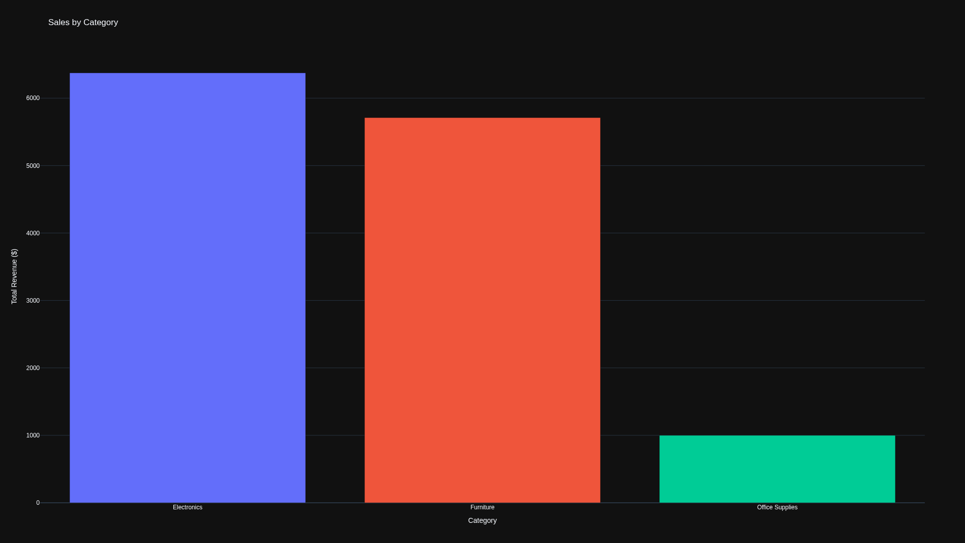
Sales by Category

Slide 4
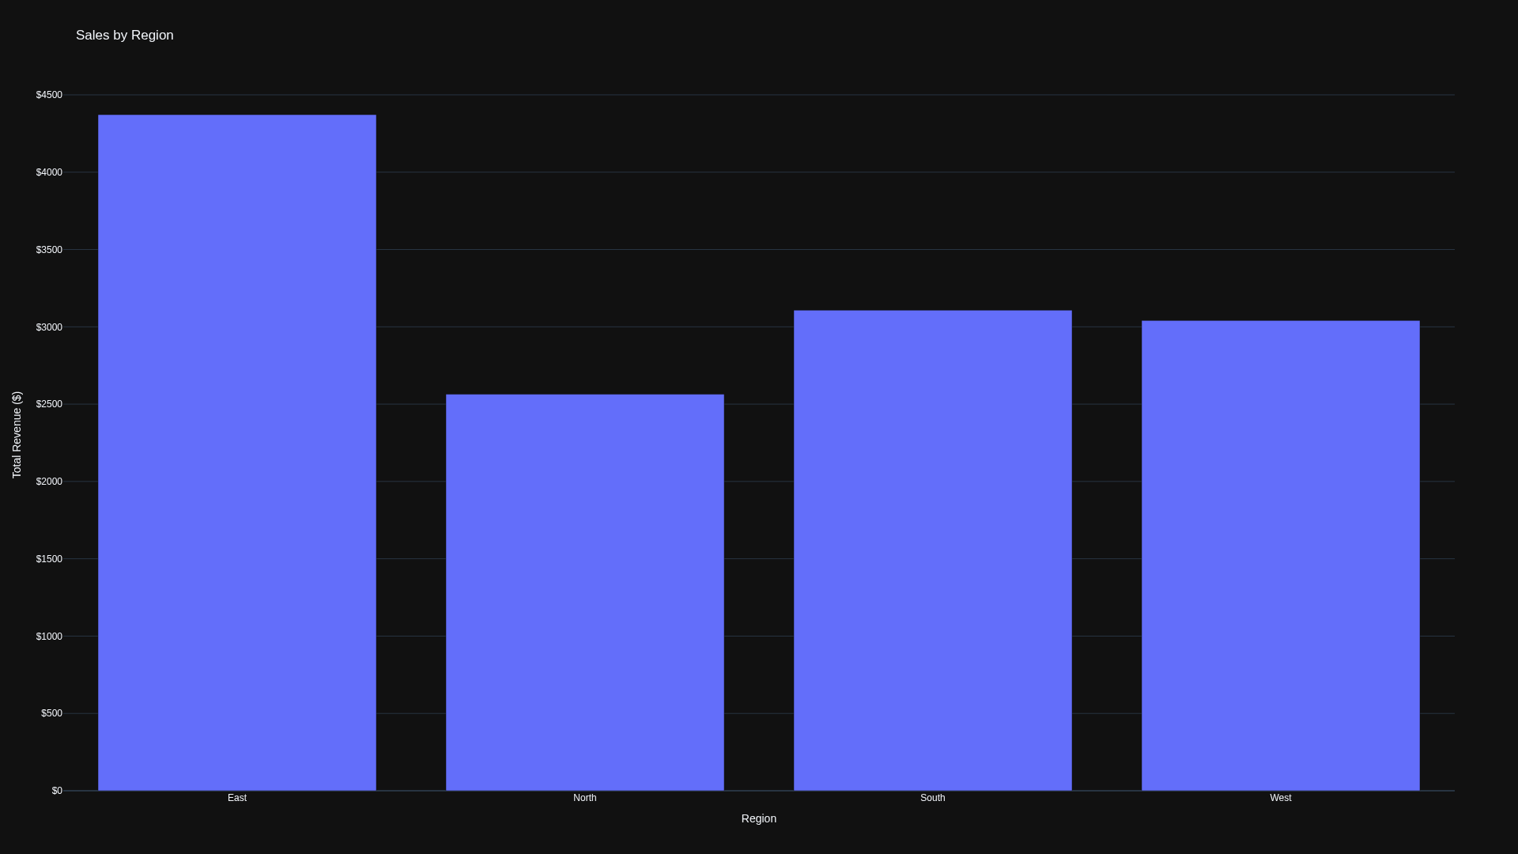
Sales by Region

Slide 5
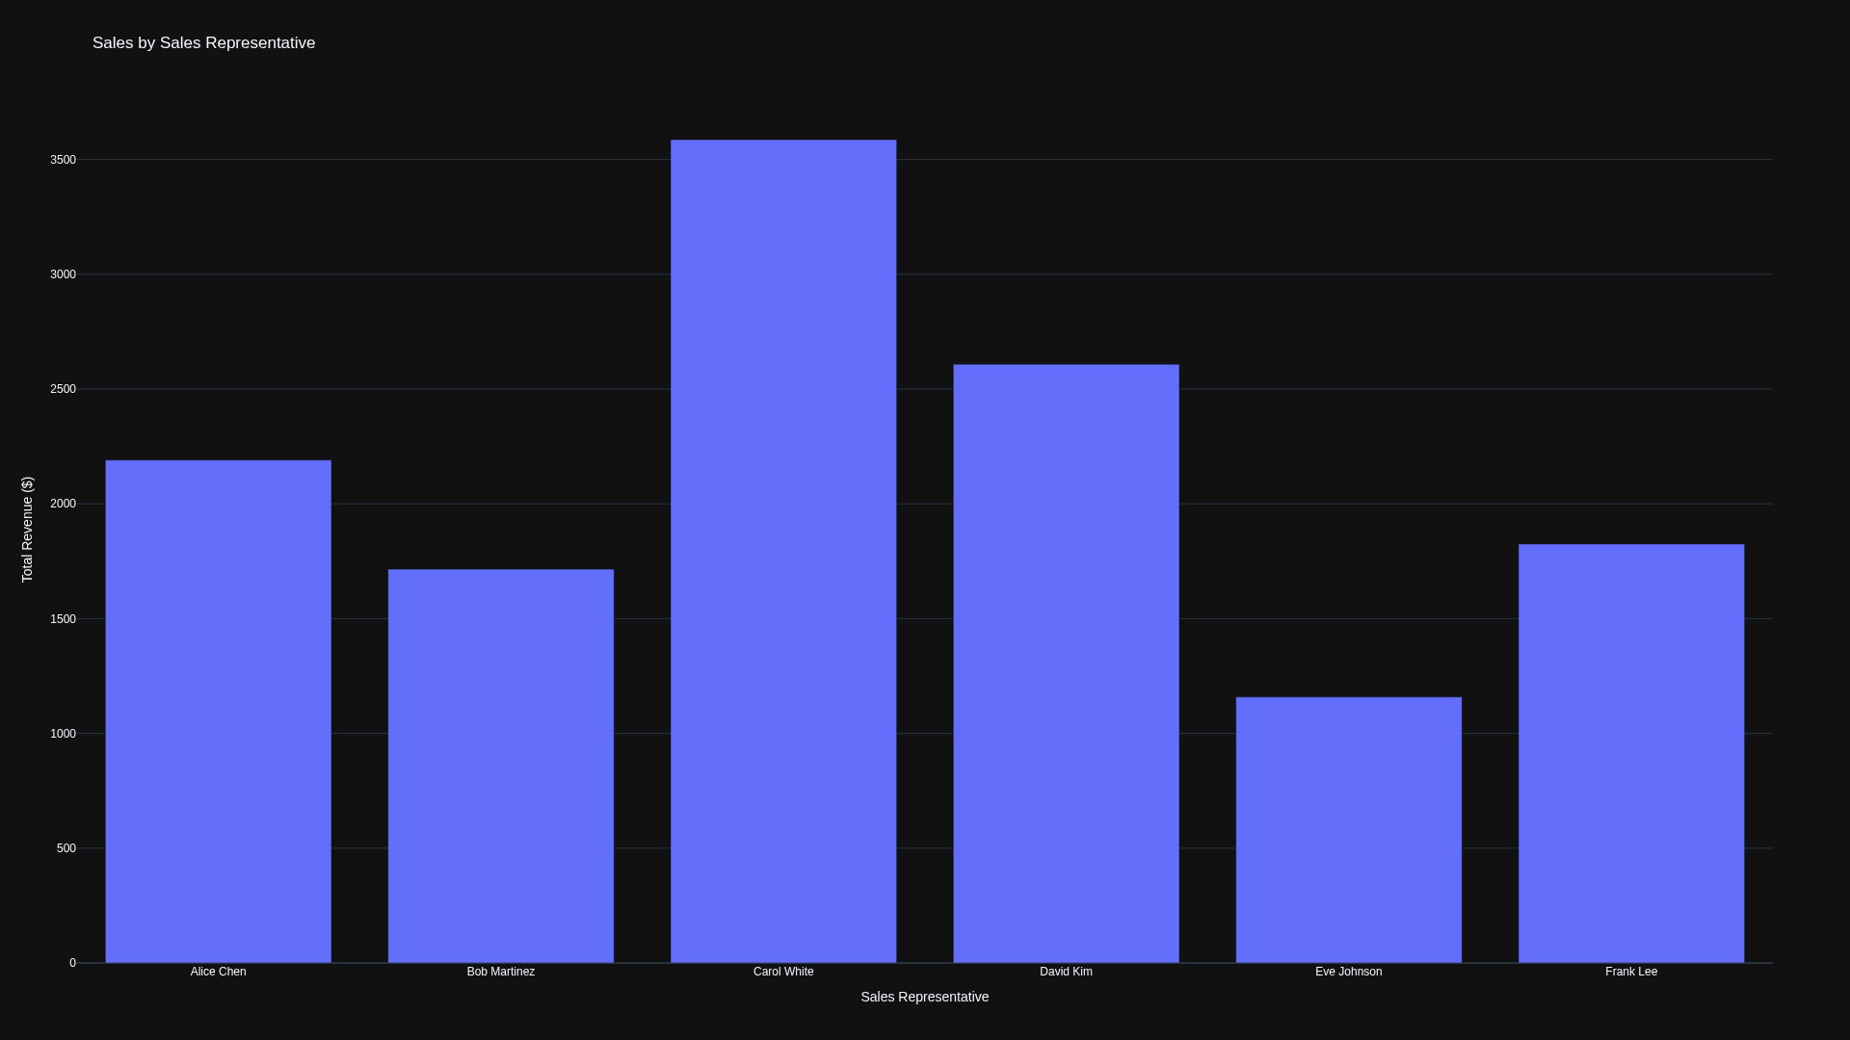
Sales by Sales Representative

Slide 6
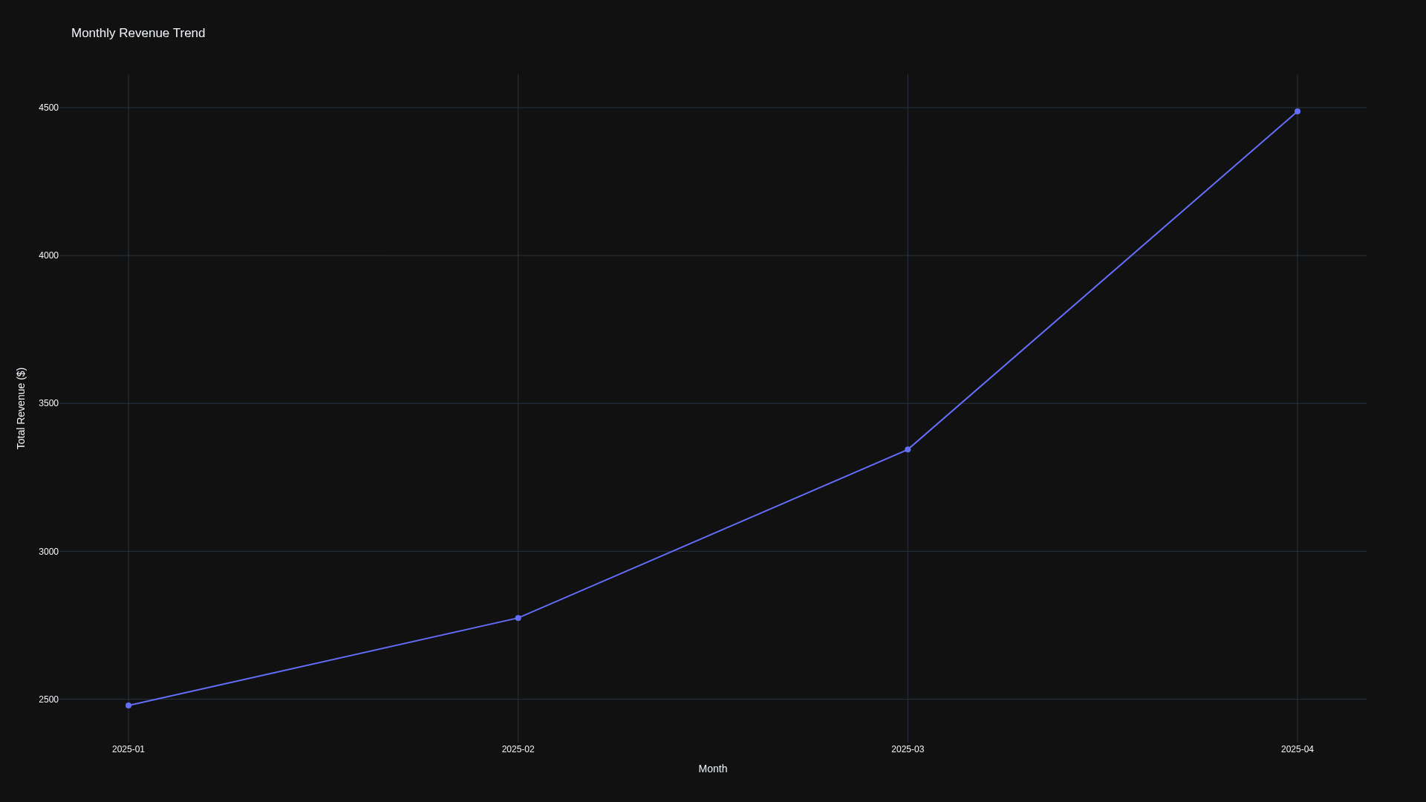
Monthly Revenue Trend

Slide 7
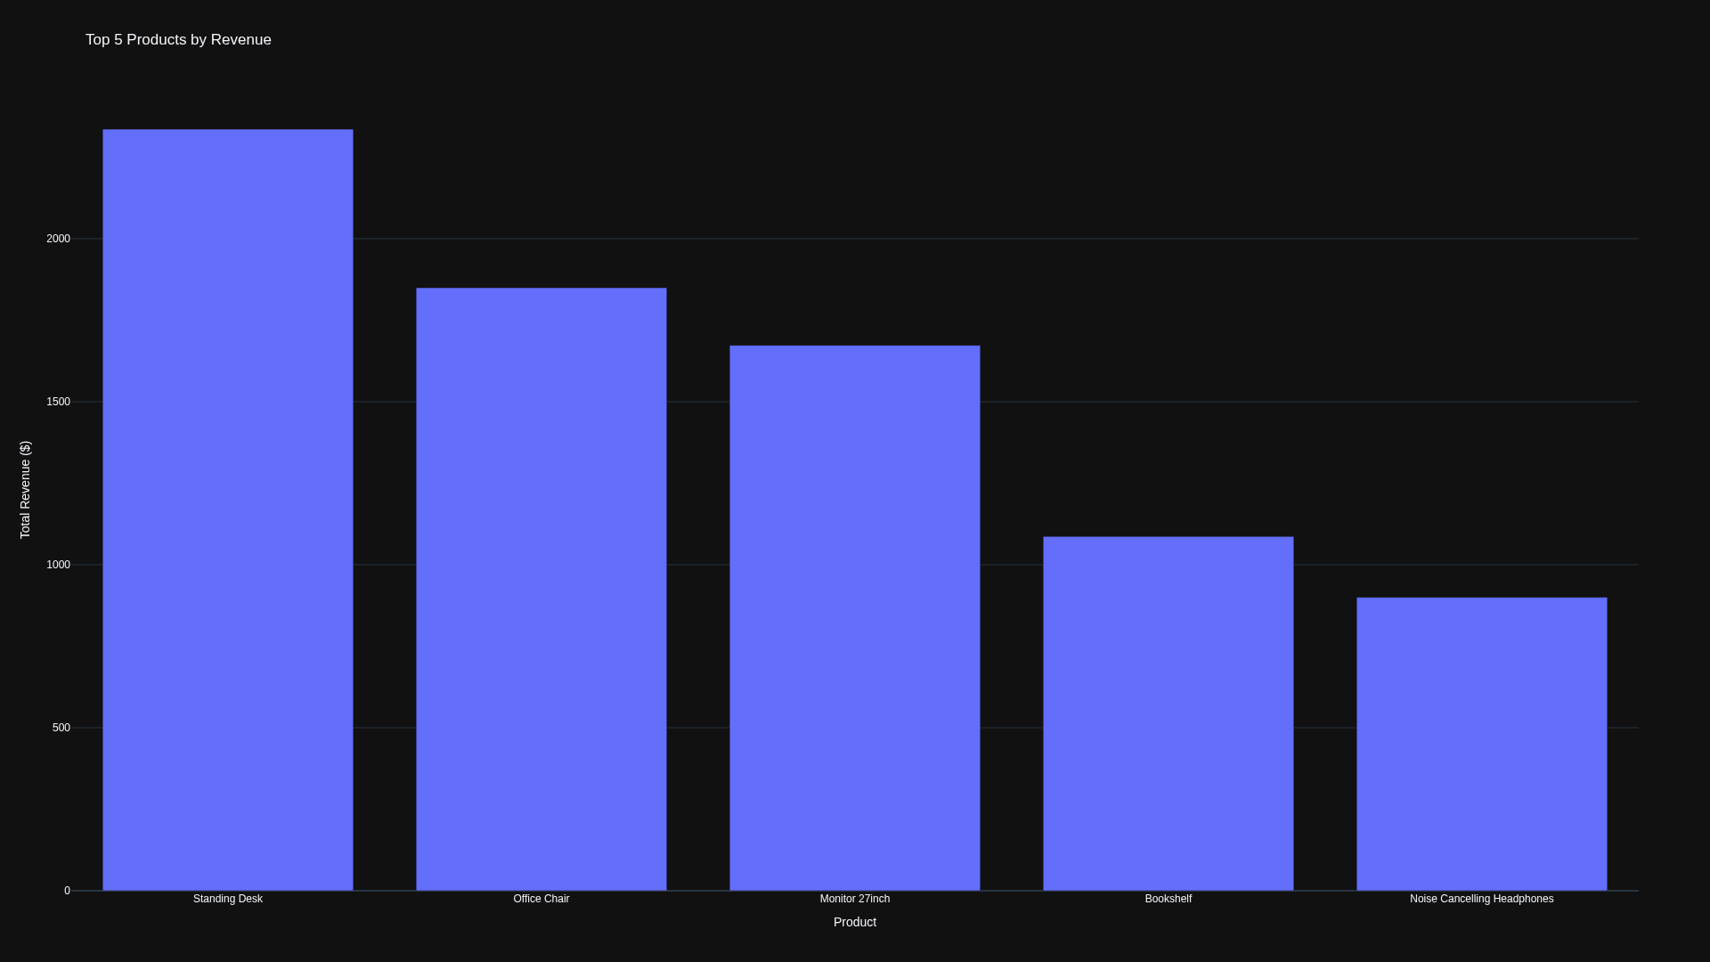
Top 5 Products by Revenue

